Slide 1
Module C
Unit C4
Vocabulary
Language Functions
Speaking Activities
UTN FRVM Lic. Evangelina Cecchel - Lic. Bibiana Fernandez

Slide 2
Language Functions:
Expressing Conditions
and their results
UTN FRVM Lic. Evangelina Cecchel - Lic. Bibiana Fernandez

Slide 3


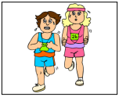
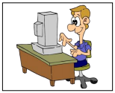

What will happen if……..?
What would happen if…..?
If you ride your bicycle carelessly …
if you go to Italy…
if you run for one hour every day.,,
if you sit in front of the computer for too long…
If the weather is sunny tomorrow …
UTN FRVM Lic. Evangelina Cecchel - Lic. Bibiana Fernandez

Slide 4
Vocabulary:
Participial Adjectives
UTN FRVM Lic. Evangelina Cecchel - Lic. Bibiana Fernandez

Slide 5
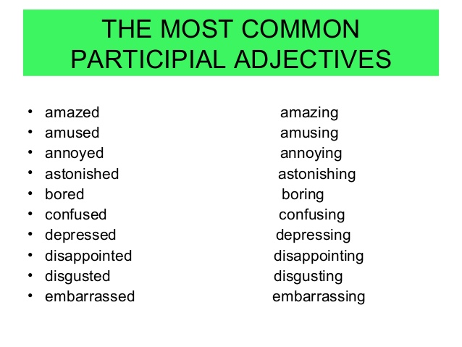
UTN FRVM Lic. Evangelina Cecchel - Lic. Bibiana Fernandez

Slide 6
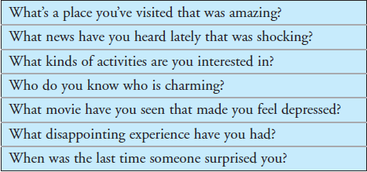
Interview: It Was Amazing
Ask/ answer the following questions
Example
A: What’s a place you’ve visited that was amazing?
B: Tahiti.
A: What was amazing about it?
B: The beaches. The water is so clear.
UTN FRVM Lic. Evangelina Cecchel - Lic. Bibiana Fernandez

